Slide 1
Chapter 2 Secret Key Encryption Standard
Chapter 2.1
Classical Encryption Principles

Slide 2
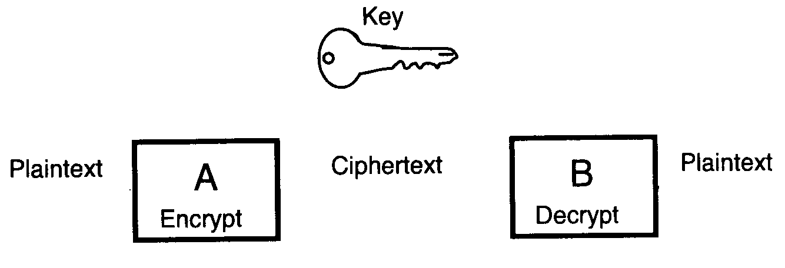
Model of Conventional Encryption
Notes:
First of all, let us study the model of conventional encryption.

Slide 3
Substitution Cipher
Substitution cipher is one in which the letters of plaintext are replaced by other letters or by numbers or symbols.
Caesar cipher is the earliest substitution cipher.

Slide 4
Caesar Cipher
The famous Roman commander-in-chief and statesman Juliu Caesar (100-44 B.C.)
The Caesar cipher involves replacing each letter of the alphabet with letter standing three places further down the alphabet.
Plaintext: a b c d e f g h i j k l m n o p q r s t u v w x y z
Ciphertext: d e f g h i j k l m n o p q r s t u v w x y z a b c
Plain = PLEASE CONFIRM RECEIPT
Cipher = SOHDVE FRQILUP UHFHLSW
Key = 3

Slide 5
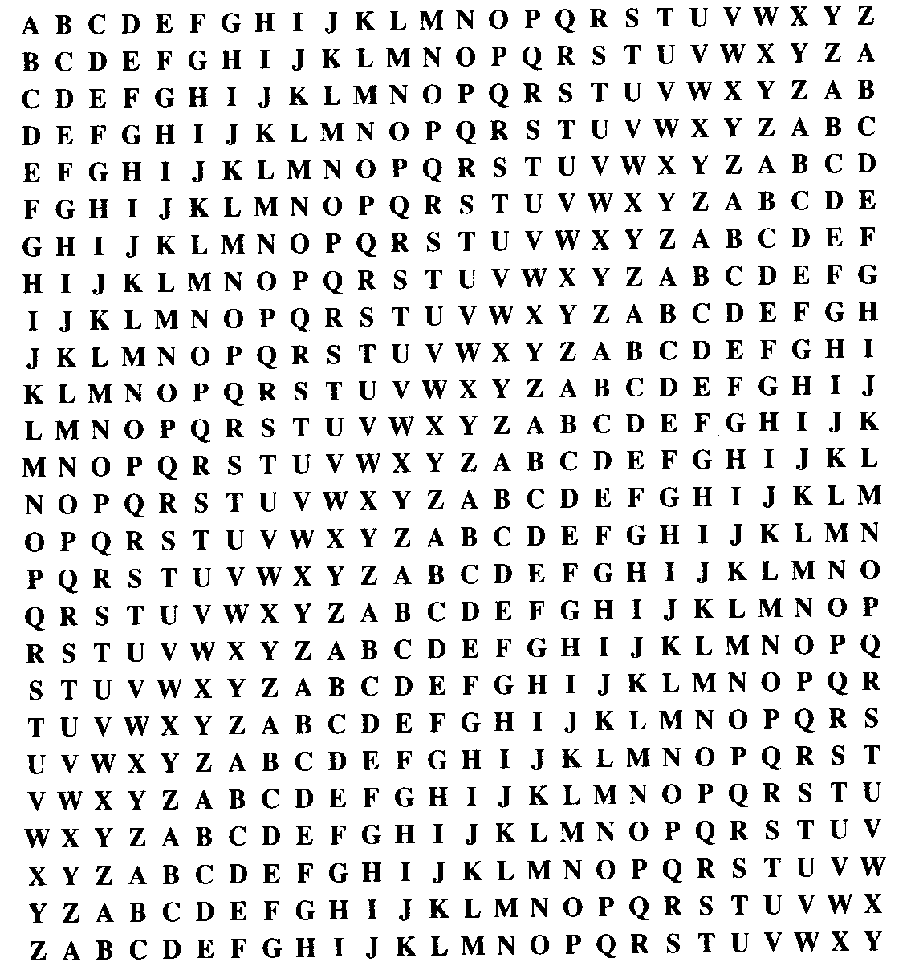
Shift Ciphers
Caesar

Slide 6
Cryptosystem
A cryptosystem is a five-tuple (P, C, K, E, D), where the following conditions are satisfied:
P is a finite set of possible plaintexts
C is a finite set of possible ciphertexts
K, the keyspace, is a finite set of possible keys
For each K, there is an encryption rule e_{K} in E and a corresponding decryption rule d_{K} in D. e_{K} : P → C and d_{K} : C →P are function such that d_{K} (e_{K} (x)) = x for every plaintext x in P.

Slide 7
Mathematical Representation of Shift Cipher
Corresponding table between alphabetic and natural number
A B C D E F G H I J K L M N O P Q R S T U V W X Y Z
0 1 2 3 4 5 6 7 8 9 10 11 12 13 14 15 16 17 18 19 20 21 22 23 24 25
Z₂₆={0,1,2,…,25}
P= Z₂₆, C= Z₂₆, K={0,1,2, …,25}
Encryption: c=E(p)=p+k (mod 26)
Decryption: p=D(c)=c-k (mod 26)
D(c)=c-k=(p+k)-k=p → D(E(p))=p
Caesar Cipher is a shift cipher with k=3.
Notes:
T u e s d a y
19 20 4 18 3 0 24
l o s i p g a
11 14 18 8 15 6 0
C=aP+b
11=a19+b
14=a20+b
a=3
B=11-3*19= -46+52=6

Slide 8
Modular Arithmetic
Definition:
x (mod n) = the remainder of x divided by n.
For example, 34 (mod 26) = 8

Slide 9
Example of Caesar Cipher
p=“y”=24,
Encryption:
c=p+3=24+3=27=26+1=1 (mod 26)=“b”
c=“b”=1,
Decryption:
p=c-3=1-3=-2=-2+26=24 (mod 26)=“y”

Slide 10
Example of Shift Cipher
k=5
Plaintext=“security” →(18,4,2,20,17,8,19,24)
c=E(p)=p+5 (mod 26)
E: (18,4,2,20,17,8,19,24) +(5,5,5,5,5,5,5)
(23,9,7,25,22,13,24,3) (mod 26)
p=D(c )=c-5 (mod 26)
D: (23,9,7,25,22,13,24,3)-(5,5,5,5,5,5,5)
(18,4,2,20,17,8,19,24) (mod 26)
s e c u r i t y

Slide 11
Question
Is it difficult to decrypt the shift cipher without knowing key? Decrypt the following shift ciphertext?
fev gfleu fw cvriezex ivhlzivj kve gfleuj fw tfddfe jvejv kf rggcp zk

Slide 12
Answer
P: a b c d e f g h i j k l m n o p q r s t u v w x y z
C: r s t u v w x y z a b c d e f g h i j k l m n o p q
P: one pound of learning requires ten pounds of
common sense to apply it
C: fev gfleu fw cvriezex ivhlzivj kve gfleuj fw
tfddfe jvejv kf rggcp zk
Comment: Shift cipher is insecure!

Slide 13
Affine Cipher
P=C=Z₂₆
K={(k₁,k₂)| k₁,k₂ ∈ Z₂₆, gcd(k₁,26)=1}
E: c=E(p)=k₁p+k₂ (mod 26)
D: p=D(c )=k₁⁻¹(c-k₂) (mod 26)
D(c )=k₁⁻¹(c-k₂)=k₁⁻¹(k₁p+k₂-k₂)=p
Note 1: gcd means greatest common divisor
Note 2: gcd(k₁,26)=1 ←→ k₁ ∈{1,3,5,7,9,11,15, 17,19,21,23,25}
Note 3: k₁ k₁⁻¹ =1 (mod 26), for example, 3*9=27=1 (mod 26)
(1,1), (3,9), (5,21), (7,15), (11,19), (17,23), (25,25)
Note 4: k₁=1, k₂=0 should be avoided because p=c in this case.

Slide 14
Example of Affine Cipher
k1=5, k2=3
p=“y”=24,
Encryption:
c=5p+3=5*24+3=123=19 (mod 26)=“t”
c=“t”=19,
Decryption:
p=5⁻¹(c-3)=21(19-3)=21*16=24(mod 26)=“y”
5*21=105=1 (mod 26)

Slide 15
Question
Is it difficult to decrypt the affine cipher without knowing keys? How many possible affine ciphers are there?

Slide 16
Number of Affine Ciphers
K={(k₁,k₂)| k₁,k₂ ∈ Z₂₆, gcd(k₁,26)=1}
k₁ ∈{1,3,5,7,9,11,15, 17,19,21,23,25}
N=12*26=312
Comments: Affine cipher is insecure!

Slide 17
Example of Breaking Affine Cipher
Given ciphertext:
fmxvedkaphferbndkrxrsrefmorudkvshvufedkaprkdlyevlrhhrh
k₁= 3, k₂=5
algoritmsarequitegeneraldefinitionsofarithmeticprocess
Resulting plaintext
Decrypt

Slide 18
Cont.
In an affine cipher, suppose that (P,R) and (G,Y) are two pairs of plaintext letters and ciphertext letters. Break the cipher.
Answer: c=k1*p+k2
P←→15, R←→17, G←→6, Y←→24
17=15*k1+k2 (mod 26)
24=6*k1+k2 (mod 26)
-7=9*k1 (mod 26)
-7*3=9*3*k1 (mod 26)
5=k1 (mod 26)
k2=24-6*k1=24-30= -6 (mod 26)
c=5p-6 →c+6=5p→21(c+6)=21*5p→p=21c+126=21c+22
A B C D E F G H I J K L M N O P Q R S T U V W X Y Z
0 1 2 3 4 5 6 7 8 9 10 11 12 13 14 15 16 17 18 19 20 21 22 23 24 25

Slide 19
Transposition Cipher
Transposition cipher is one in which the letters of plaintext remain what they are, but not where they were.
Transposition cipher only alters the order of the letters of the plaintext.
The Scytale is the prototype of a transposition cipher.
Notes:
25

Slide 20
Transposition Cipher Based on Key Word
The ciphertext is obtained by changing the column of the plaintext according to the alphabetic order of the letters of a key word.
Plaintext=THE MEETING HAS BEEN POSTPONED UNTIL NEXT MONTH
Key Word = STOCK
S, T, O, C, K
4, 5, 3, 1, 2
Notes:
28

Slide 21
Encryption and Decryption
Plaintext
THEME
ETING
HASBE
ENPOS
TPONE
DUNTI
LNEXT
MONTH
1 2 3 4 5
T H E M E
E T I N G
H A S B E
E N P O S
T P O N E
D U N T I
L N E X T
M O N T H
4 5 3 1 2
T H E M E
E T I N G
H A S B E
E N P O S
T P O N E
D U N T I
L N E X T
M O N T H
Ciphertext= MNBONTXT EGESEITH EISPONEN TEHETDLM HTANPUNO
Notes:
29

Slide 22
Question
Is it difficult to decrypt the transposition cipher with key word without knowing key word? How to decrypt the following ciphertext obtained by a transposition cipher with 4 letters key word?
iukrfneul yooeolysu fwysdsprf orulweoep
Notes:
30

Slide 23
Answer
ciphertext
plaintext
1 3 2 4
i f y o
u w o r
k y o u
r s e l
f d o w
n s l e
e p y o
u r s e
l f u p
Permutation of 1,2,3,4
1234, 1243, 1324, 1342, 1423, 1432
2134, 2143, 2314, 2341, 2413, 2431
3124, 3142, 3214, 3241, 3412, 3421
4123, 4143, 4213, 4231, 4312, 4321
Plaintext: if you work yourself down sleep yourself up
Key: 1324
Notes:
31

Slide 24
Comments
Key Word = m distinct letters
Permutation of 1,2,…,m
The total number=m! possibilities
Test each possibility to determine key
It is insecure when m is small
Notes:
m factorial.

Slide 25
Chapter 2 Secret Key Encryption Standard
Chapter 2.2
Simplified Advanced Encryption Standard

Slide 26
Advanced Encryption Standard
DES cracked, Triple-DES slow: what next?
1997: NIST AES announced, call for algorithms
August 1998: 15 candidate algorithms
August 1999: 5 finalists
October 2000: Rijndael selected
Two Belgians: Joan Daemen, Vincent Rijmen
May 2001: Comment period ended
Summer 2001: Finalized, certified until ‘06
Notes:
National Institute of Standards and Technology

Slide 27
AES vs. DES
Similar to DES: block cipher (with different modes), but 128-bit blocks
128-bit, 192-bit, or 256-bit key
Mix of permutations, “S-boxes”
S-boxes based on modular arithmetic with polynomials.
Notes:
In cryptography, a Feistel cipher is a symmetric structure used in the construction of block ciphers, named after the German-born physicist and cryptographer Horst Feistel who did pioneering research while working for IBM (USA); it is also commonly known as a Feistel network.

Slide 28
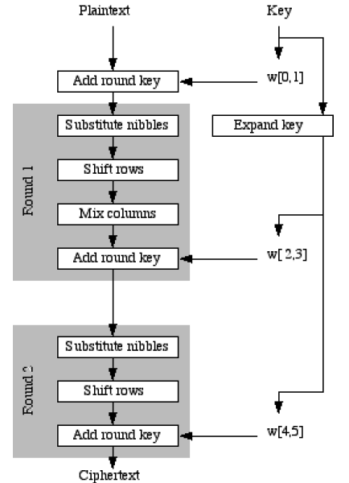
Simplified AES
16 bits
16 bits
16 bits
Notes:
Mohammad Musa, Edward Schaefer, and Stephen Wedig, A simplified AES algorithm and its linear and differential cryptanalyses, Cryptologia 27 (April 2003), 148–177.
https://sandilands.info/sgordon/teaching/reports/simplified-aes-example.pdf

Slide 29
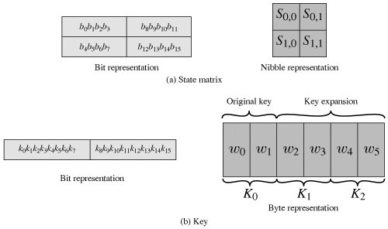
State Matrix and Round Keys

Slide 30
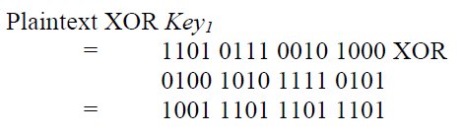
Add Round Key

Slide 31
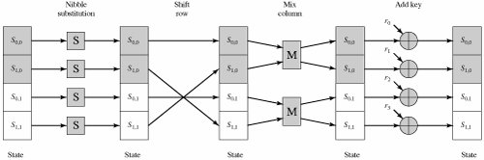
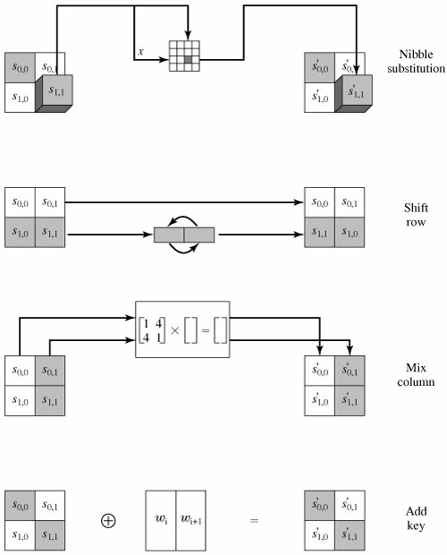
Encryption Round

Slide 32
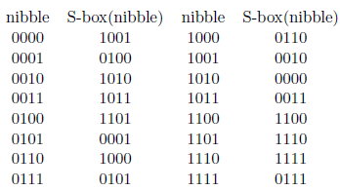

Substitution
Notes:
In computing, a nibble (often nybble or even nyble to match the vowels of byte) is a four-bit aggregation, or half an octet. As a nibble contains 4 bits, there are sixteen (24) possible values, so a nibble corresponds to a single hexadecimal digit (thus, it is often referred to as a "hex digit" or "hexit").

Slide 33
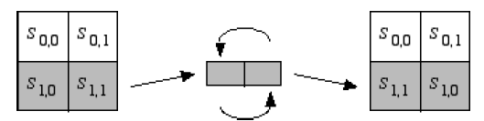

Shift Rows

Slide 34
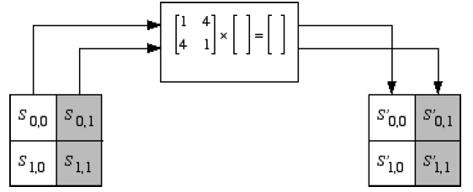

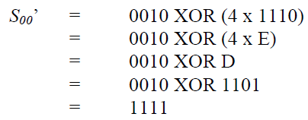
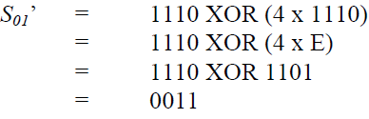

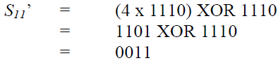
Mix Columns

Slide 35
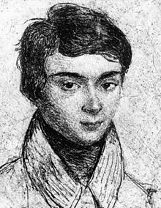
Galois Field
Évariste Galois (French: [evaʁist ɡalwa]) (25 Oct. 1811 – 31 May 1832) was a French mathematician born in Bourg-la-Reine. While still in his teens, he was able to determine a necessary and sufficient condition for a polynomial to be solvable by radicals, thereby solving a long-standing problem. His work laid the foundations for Galois theory and group theory, two major branches of abstract algebra, and the subfield of Galois connections. He was the first to use the word “group” (French: groupe) as a technical term in mathematics to represent a group of permutations. A radical Republican during the monarchy of Louis Philippe in France, he died from wounds suffered in a duel under questionable circumstances at the age of twenty.
Notes:
Duel: a prearranged contest with deadly weapons between two people in order to settle a point of honour.

Slide 36
GF(16)
GF(16)={0, 1, 2, …, 15}
Polynomial representation
0, 1, 2=x, 3=x+1, …, 15=x³+x²+x+1, modulo x⁴+x+1
Addition
a + b = a XOR b, e.g., 1 + 3 = 01 XOR 11 = 10 = 2
a XOR a=0 → a = -a
Multiplication
a*b = polynomial of a * polynomial of b (mod x⁴+x+1)
e.g., 4*14=x²*(x³+x²+x)= x⁵+x⁴+x³
=(x+1)(x⁴+x+1)+(x³+x²+1)=0+13=13
Notes:
Galois Field GF(2m) Calculator
http://www.ece.unb.ca/cgi-bin/tervo/calc2.pl

Slide 37
Addition and Multiplication over GF(16)
Addition: 1 + 3 = 01 XOR 11 = 10 = 2
Multiplication: 3*14 (mod 10011) = ?
3*14=11 x 1110 = 10010 (mod 10011) = 1 = 0001
x⁴+x+1=10011
1110 ____1_
x 11 10011 / 10010
1110 10011
+ 1110__ 1
10010

Slide 38
Matrix Multiplication over GF(16)
=
1x0010+4x1110 (mod 10011) = 0010+1101=1111
4*1110=100 x 1110 = 111000 (mod 10011) = 1101
1110 ____11
X 100 10011 / 111000
0000 10011
0000 11110
+1110__ 10011
111000 1101
1 | 4
4 | 1
0010
1110
1111
0011
Notes:
Galois Field GF(2m) Calculator
http://www.ece.unb.ca/cgi-bin/tervo/calc2.pl

Slide 39
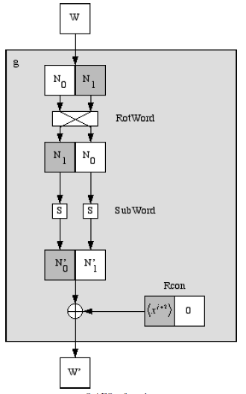
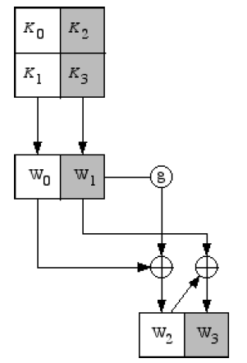
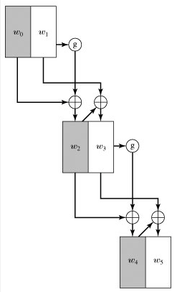
Key Expansion
Notes:
Key expansion is done very similarly to AES. The four nibbles in the key
are grouped into two 8-bit “words”, which will be expanded into 6 words. The first part of the
expansion, which produces the third and fourth words, is shown below. The rest of the expansion
is done in exactly the same way, replacing W0 and W1 with W2 and W3, and replacing W2 and W3
with W4 and W5.
The g function is shown in the next diagram. It is very similar to AES, first rotating the nibbles
and then putting them through the S-boxes. The main difference is that the round constant is
produced using x^{j+2}, where j is the number of the round of expansion. That is, the first time you
expand the key you use a round constant of x3 = 1000 for the first nibble and 0000 for the second
nibble. The second time you use x4 = 0011 for the first nibble and 0000 for the second nibble.

Slide 40
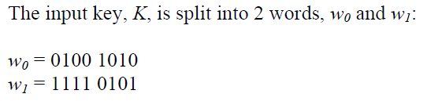


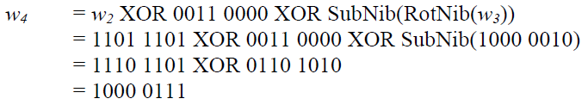

Example

